Slide 1


Android Wear: A Developer’s Perspective
Marc Lester Tan
Mobility Innovation Center, APJ
w: marctan.com
t: @mharkus
+MarcLesterTan

Slide 2

Agenda
Introduction to Android Wear
Notifications
Wearable Apps
Watch Faces
Demo
Notes:
Introduction to Android Wear
Present the problem that Android Wear is trying to solve
Short introduction as to what Android wear is
Hello, Hello! Notifications
Notifications from existing apps
Customization of notifications specifically for Android Wear
Stacks
Pages
Replies
Wearable Apps
Creating Wearable App
Data Exchange Types
Custom Layouts
Voice Actions
Watch Faces
Creating a watchface
Demo
Notifications
Wolfram Integration
Google-Inspired Watch Face

Slide 3

Notes:
There’s definitely something wrong about this picture
You are supposed to be connected to the people around you and not to those who are not currently with you

Slide 4

Notes:
Google has been trying hard to solve that problem and Android wear aims to solve that
By giving you contextual information at the right moment, in just a glance

Slide 5
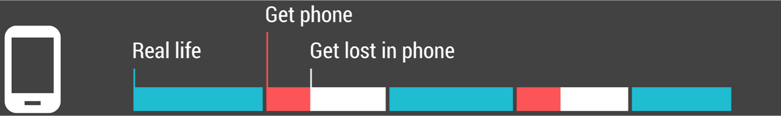
Notes:
There are lots of times where we get lost in phone
And we tend to keep on checking the notifications on our phone particularly during special events in which you are supposed to be enjoying the moment with your loved ones.

Slide 6
Notes:
With wearables, this is what your typical day timeline will look like.
You stay connected with the people around you, but still get enough time to be connected to the virtual world.

Slide 7
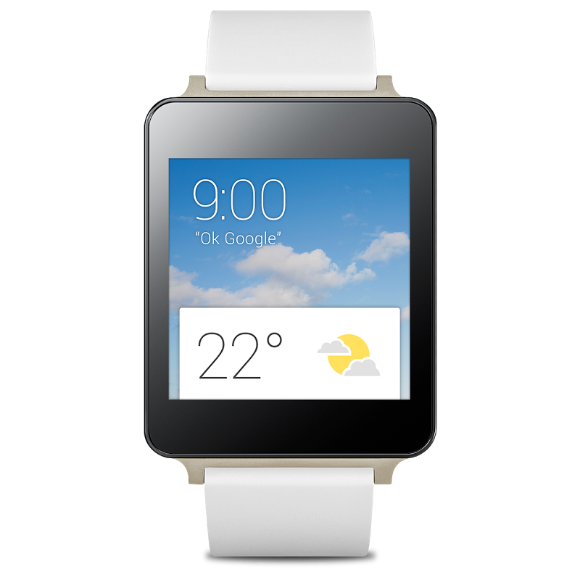
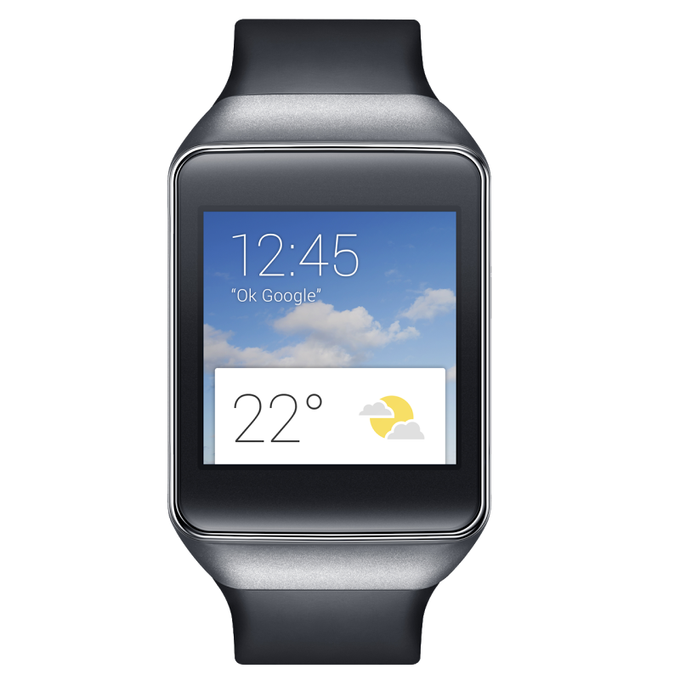
Notes:
Android Wear by definition is a set of APIs based on Android operating system designed specifically for wearables such as smartwatches.
Simple, glanceable, built around micro-interactions
It was announced this year (2014) and launched during Google I/O this year as well
This is in partnership with Motorola, Samsung, LG, HTC and ASUS

Slide 8

Notifications
Notes:
Now let’s talk about Notifications

Slide 9
Simple Notification
PendingIntent pendingIntent = createIntent(); NotificationCompat.Builder builder = new NotificationCompat.Builder(this) .setContentTitle(“Message from Weng”) .setContentText(“Don’t forget to try Penang Laksa!”)
.setSmallIcon(R.drawable.ic_launcher)
.setContentIntent(pendingIntent);
notificationMgr = NotificationManagerCompat.from(this);
notificationMgr.notify(0, builder.build());
Notes:
This is how to build a simple notification for handheld device
Create a pending intent
Create a notification by using the builder that is part of the Notification compatibility library
Create an instance of notification manager
Send the notification

Slide 10
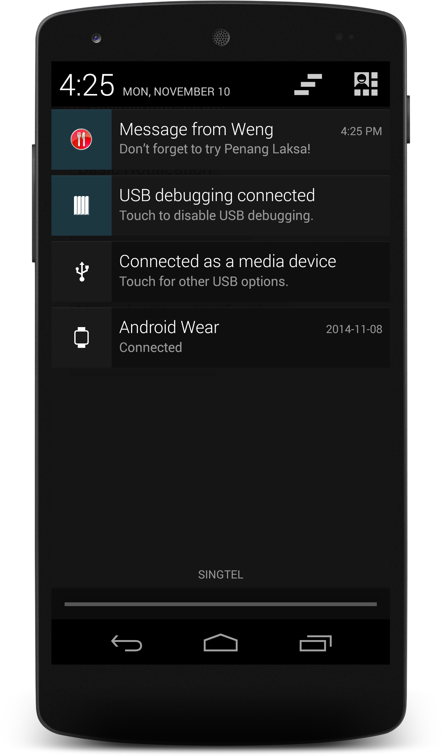
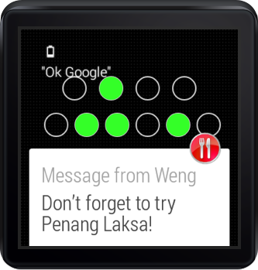
Notes:
This is how it looks on a handheld device and wearable device

Slide 11
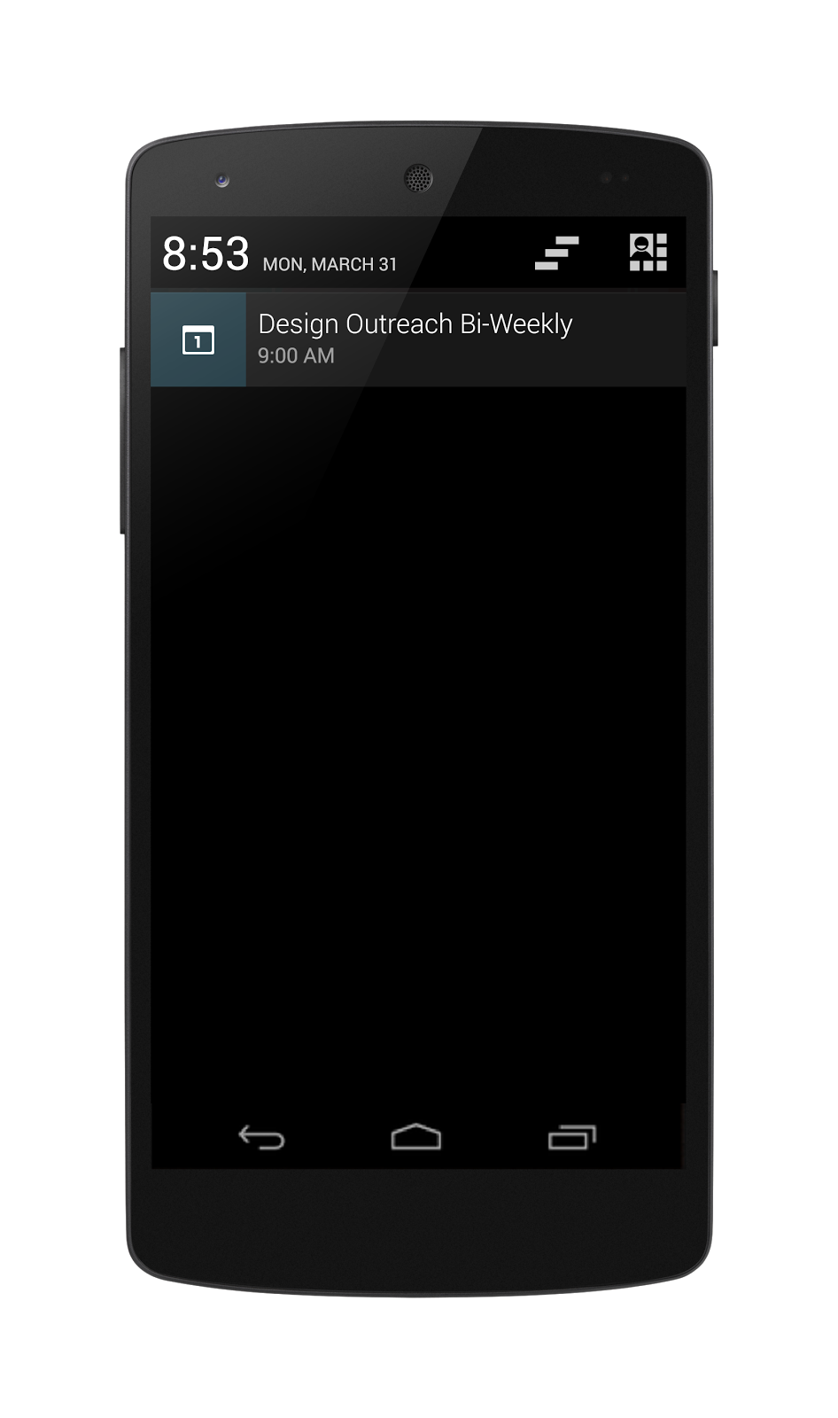
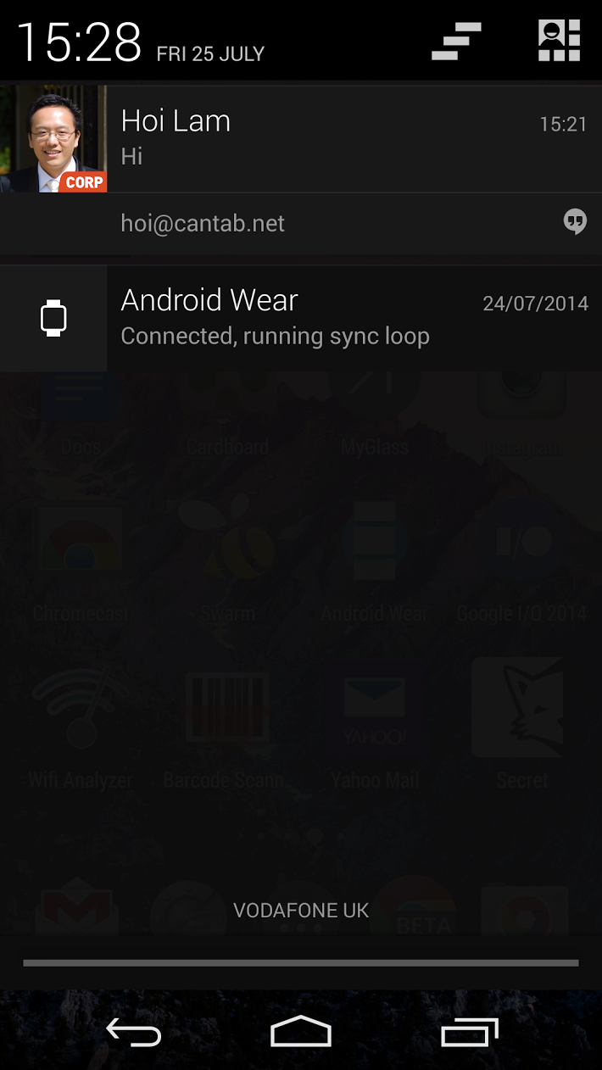

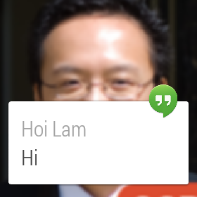
Notes:
Existing notifications on your phone will be displayed on the wearable
And to get this done…

Slide 12
NO WORK REQUIRED
Notes:
…you don’t have to do anything
It already works out of the box.
Also, notifications that buzz or sound on the companion device, will also buzz on the wearable

Slide 13
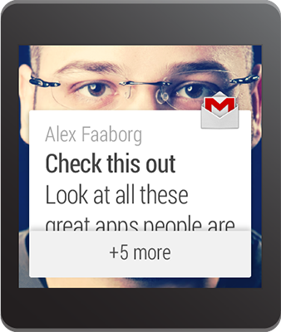
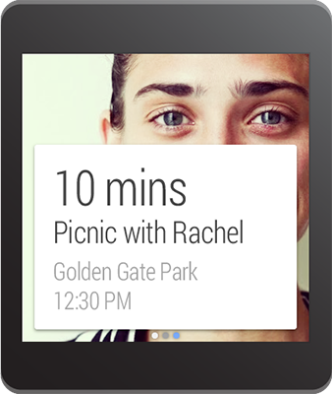
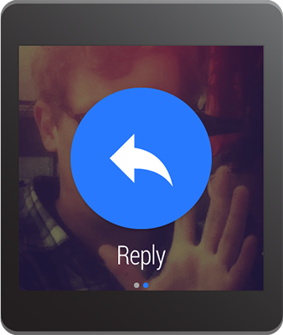
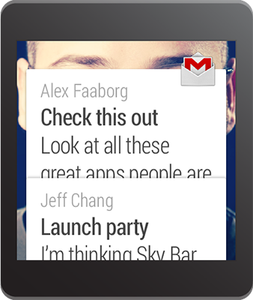
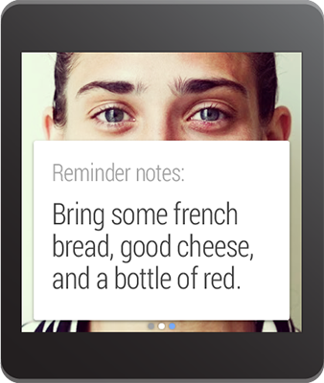
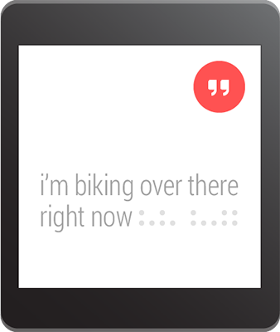
Stacks
Pages
Replies
Notes:
And that is why Android wear provided us with three more features you can easily take advantage of by adding a few more lines of code to your Android app

Slide 14

Stacked Notifications
Notes:
Stacks are like inbox-style notifications. You can deliver multiple items in a single bundle
Let’s take a look on how this is implemented in code

Slide 15
Stacked Notifications
builder1 = createNotification(“Don’t forget to try Penang Laksa!”);
builder1.setGroup("MESSAGES_GROUP_KEY”);
builder2 = createNotification(“Also their Char Koay Teow!”);
builder2.setGroup("MESSAGES_GROUP_KEY”);
summary = createNotification(“2 Messages from Weng”);
summary.setGroup(”MESSAGES_GROUP_KEY”);
summary.setGroupSummary(true);
notificationMgr.notify(0, builder1.build());
notificationMgr.notify(1, builder2.build());
notificationMgr.notify(2, summary.build());
Notes:
Here, we are creating 3 notifications
First two are actual messages
Last one is the summary notification
All of them can be bundled together using the setGroup method
Send all of the notifications through the notify method

Slide 16
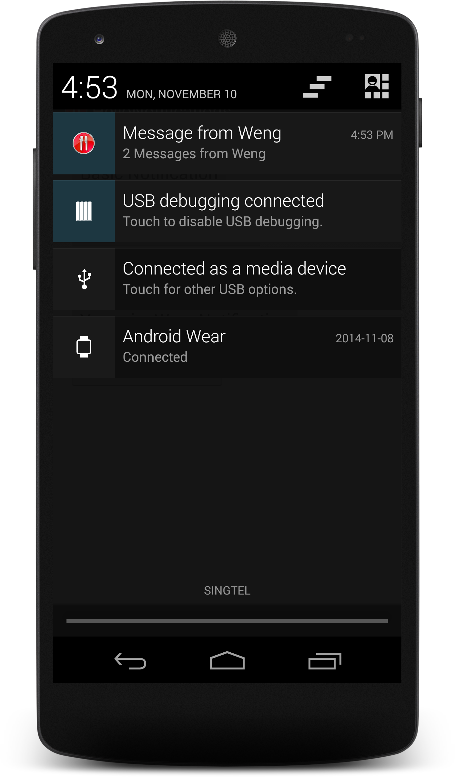
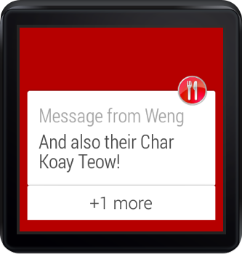
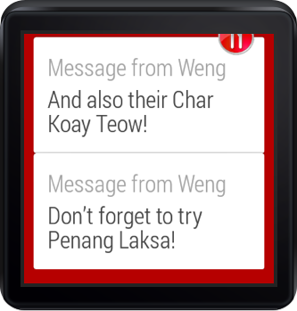
Notes:
Stacked notifications allow you to group multiple similar notifications into a single card which users can expand to view the details from each notification separately.
Summary notification will only be displayed on the handheld device.

Slide 17

Pages
Notes:
Pages are for showing multiple screens of information on the same topic, but remember to stay glance able and try to keep things short and simple

Slide 18
Pages
NotificationCompat.BigPictureStyle style = new NotificationCompat.BigPictureStyle(); style.setBigContentTitle(”Penang Laksa"); pageNotif = NotificationCompat.Builder(this) .setStyle(style) .setContentText("Mouth Watering!") .extend(new NotificationCompat.WearableExtender() .setBackground(penangLaksaBitmap) .build();
Notes:
First, we build our page, which is basically another notification
We need to specify the card style that we want to use:
There are 3 styles available for pages:
BigPictureStyle
BigTextStyle
InboxStyle

Slide 19
Pages
builder1 = createNotification(“Don’t forget to try Penang Laksa!”);
wearableExtender = new NotificationCompat.WearableExtender() .setHintHideIcon(true) .setBackground(mainbgBitmap) .addPage(pageNotif);
builder1.extend(wearableExtender);
notificationMgr.notify(0, builder1.build());
Notes:
then let’s build our main notification
Extend the main notification and add the page that we have created previously
Send the notification

Slide 20
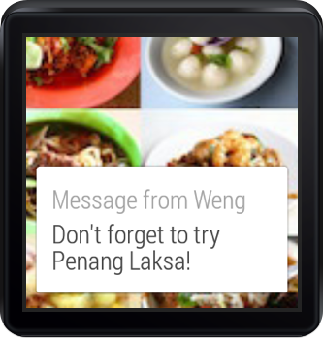
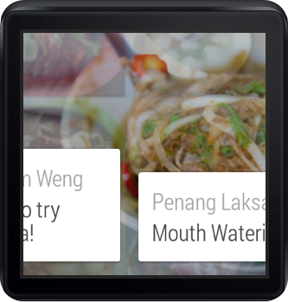
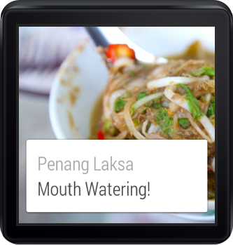
Notes:
The main notification displays on the handheld
But in the wearable device, you will see another page when you swipe to the left.

Slide 21

Replies
Notes:
Replies allow the user to reply directly from the wearable via voice.

Slide 22
Replies
RemoteInput remoteInput = new RemoteInput.Builder("extra_voice_reply”) .setLabel("What do you think?") .setChoices(new String[]{ "Awesome", "Shiok!", "Nom nom nom!" }) .build();
Notes:
To build a reply action, first create a remote input object.
You can specify the label as well as the pre-defined choices
The choices allows the user to scroll through the choices quickly

Slide 23
Replies
Action action = new Action.Builder(replyIcon,"Reply”, replyPendingIntent) .addRemoteInput(remoteInput) .build();
builder1 = createNotification(“Don’t forget to try Penang Laksa!”);
builder1.extend(wearableExtender.addAction(action));
notificationMgr.notify(0, builder1.build());
Notes:
Next, create an Action object and specify the remote input that we have created previously.
replyPendingIntent points to a class that will receive the intent after the user finishes the reply.
Create the main notification and extend it.
Add the action object to your main notification
Send the notification

Slide 24
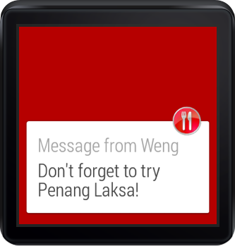
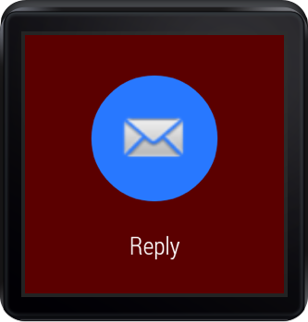
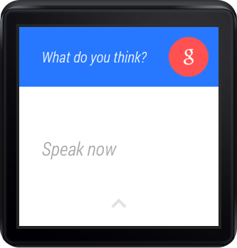
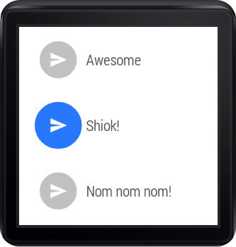
Notes:
So this is how it looks like when a notification has a reply action
Users can easily respond to the message by either saying their response or by selecting from pre-defined response

Slide 25
Receiving Voice Input
Bundle remoteInput = RemoteInput.getResultsFromIntent(getIntent());
if (remoteInput != null) {
reply = remoteInput.getCharSequence("extra_voice_reply”); }
Notes:
Remember that we have a replyPendingIntent that points to a class to receive the Intent.
This is a sample code that will fetch the actual text response from the voice input
Do not use Intent.getExtras() to obtain the voice result, because the voice input is stored as ClipData. The getResultsFromIntent() method provides a convenient way to receive a character sequence without having to process the ClipData yourself.

Slide 26

Wearable Apps
Notes:
Now let’s talk about Wearable Apps

Slide 27
Wearable Apps
Run directly on the device
Access to sensors and GPU
Greatly differ in design and usability
Limited functionality

Slide 28
Wearable vs Handheld Apps
System enforces timeout period
Relatively small in size and functionality
Users don’t download apps directly to wearable
Don’t support the following APIs
android.webkit
android.print
android.app.backup
android.appwidget
android.hardware.usb
Notes:
System enforces timeout period
If you are displaying an activity and user's don't interact with it, the device sleeps. When it wakes back up, the Wear home screen is displayed instead of your activity. If you need to show something persistent, create a notification in the context stream instead.
Relatively small in size and functionality
They contain only what makes sense on the wearable, which is usually a small subset of the corresponding handheld app. In general, you should carry out operations on the handheld when possible and send the results to the wearable.
Users don’t download apps directly to wearable
Instead, you bundle the wearable app inside the handheld app. When users install the handheld app, the system automatically installs the wearable app. However, for development purposes, you can still install the wearable app directly to the wearable.
Don’t support the following APIs
You can check if a wearable supports a feature by calling hasSystemFeature() before trying to use an API.

Slide 29

Creating Wearable Apps
Notes:
I’ll quickly go through the wizard screens in Android Studio on how to create a wearable app

Slide 30
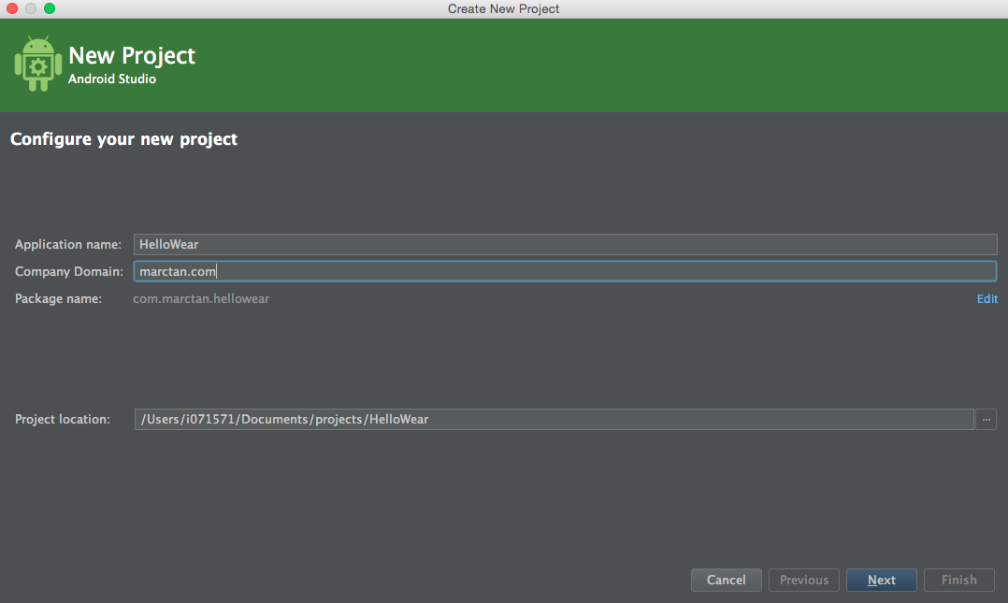
Creating Wearable Apps
Notes:
Specify your application name and company domain. The company domain will be used as part of the classes’ package name as well as the app’s identifier

Slide 31
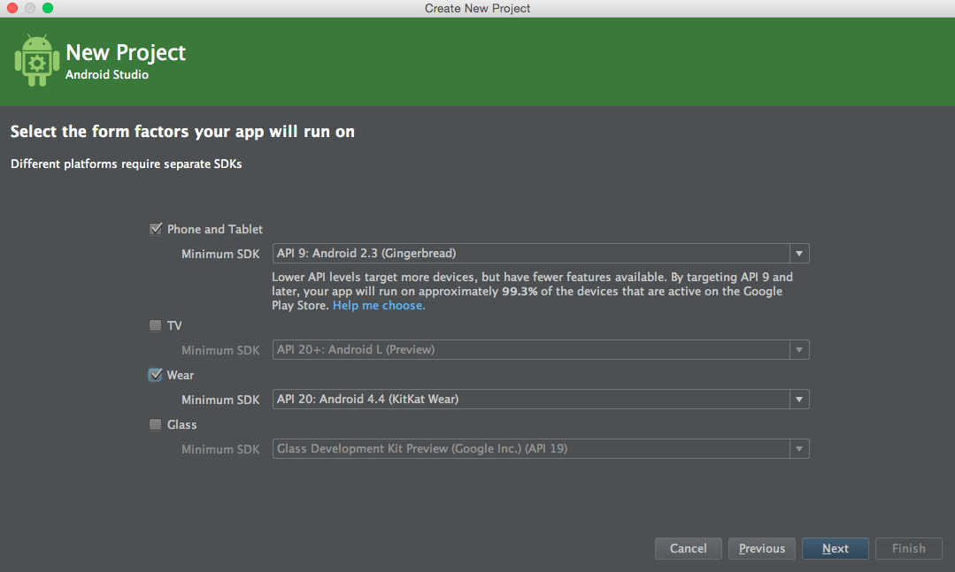
Creating Wearable Apps
Notes:
Here, you can specify the minimum API level that your app is going to support. And since we are building app for Android Wear, we need to check the Wear checkbox and select the minimum SDK to be API 20.

Slide 32
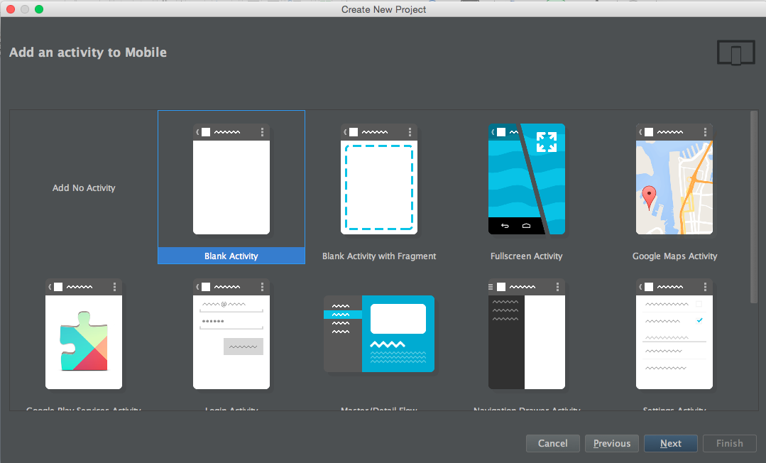
Creating Wearable Apps
Notes:
You can specify the type of activity that you want to use for the handheld app

Slide 33
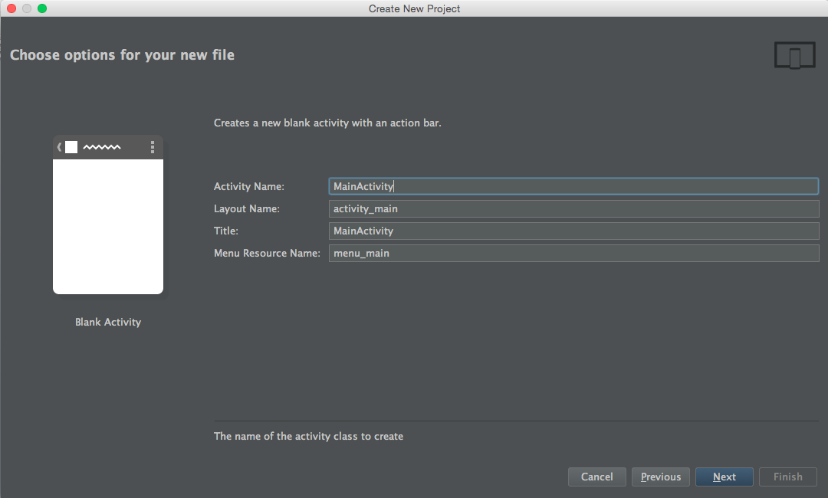
Creating Wearable Apps
Notes:
Set the activity name as well as the activity’s layout name

Slide 34
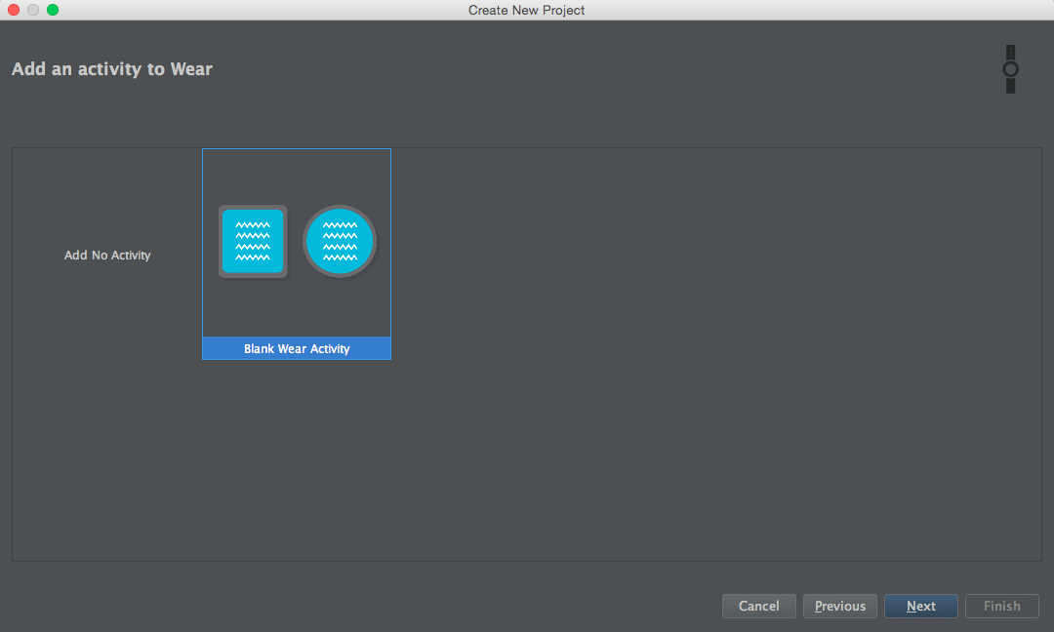
Creating Wearable Apps
Notes:
And you can also specify the type of activity for the wearable app. But as of now, you can only choose black wear activity.

Slide 35
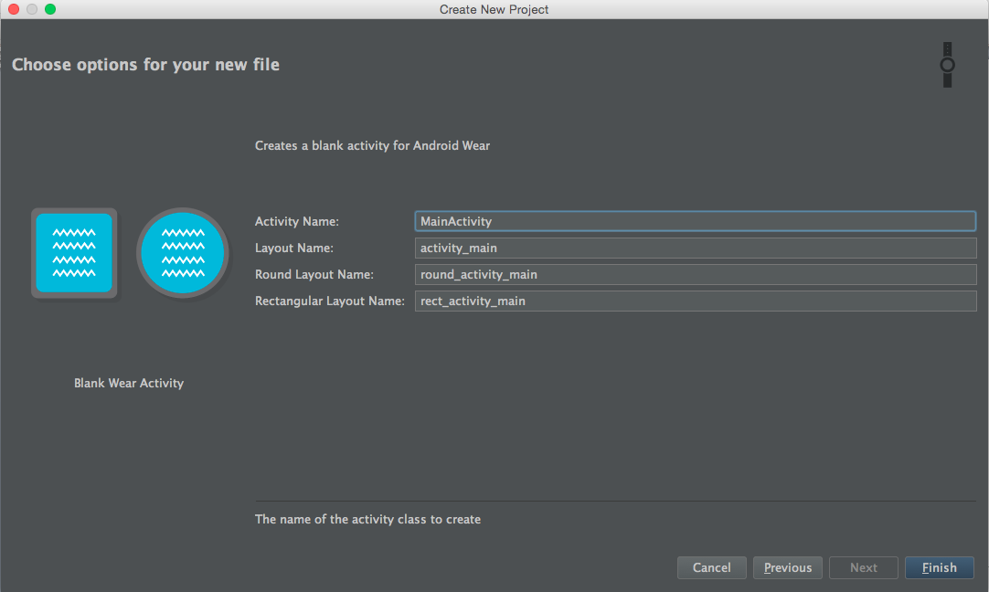
Creating Wearable Apps
Notes:
Of course, you can also specify the activity’s name and layout name

Slide 36
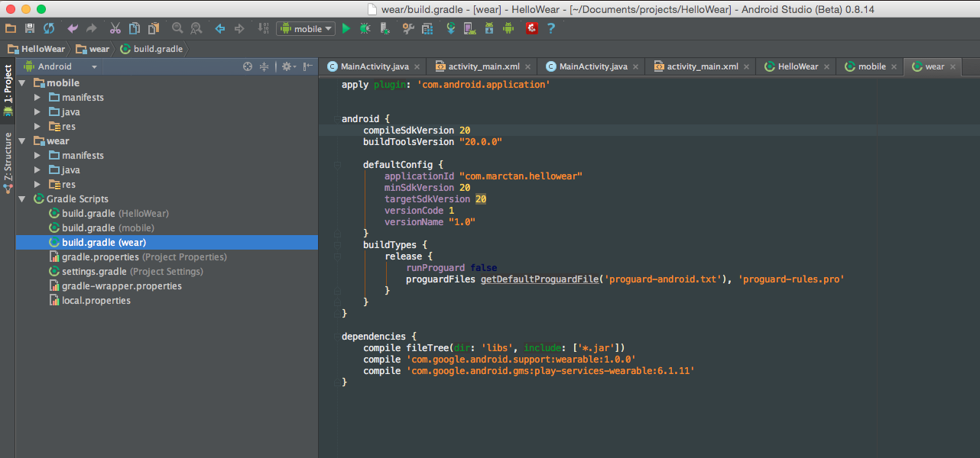
Creating Wearable Apps
Notes:
After the wizard, you’ll see a project structure similar to this. The project has two modules: one for handheld app called mobile and one for wearable app called wear.
If you want to deploy and test your handheld app, just select mobile from the Run dropdown, otherwise, choose Wear to deploy and test your wearable app.

Slide 37
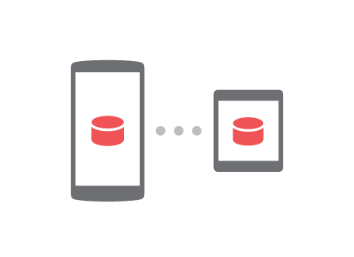
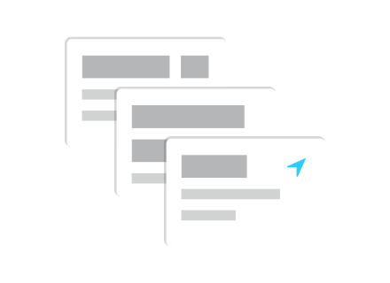
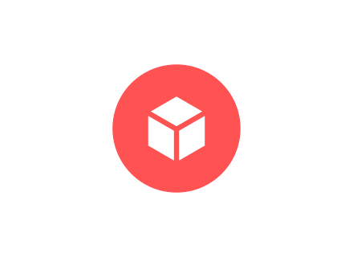
Data Exchange
Custom UI
Voice Actions
Notes:
Sharing data between the phone and the wearable
Custom UI options
How to integrate voice

Slide 38
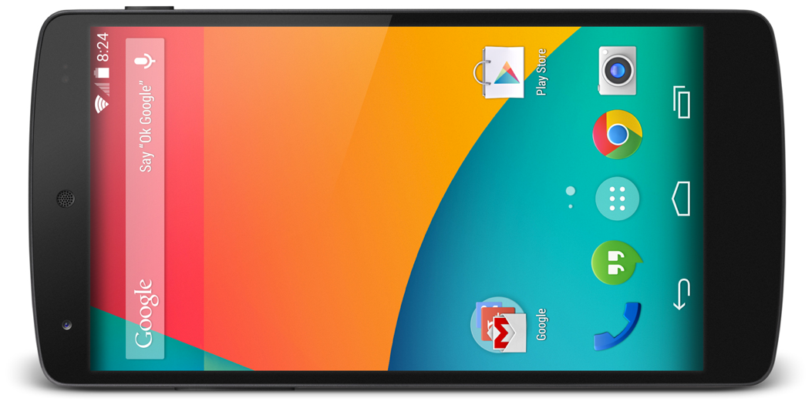

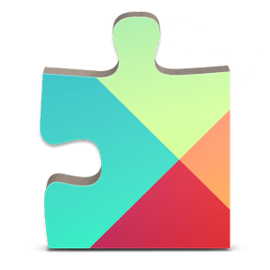
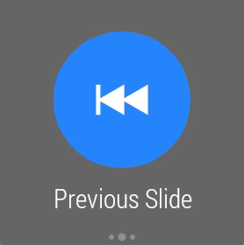
Notes:
The connection between phone and wearable is provided by Google Play Services
The application can send data between the phone and the watch through asynchronous calls via Google Play Services.

Slide 39
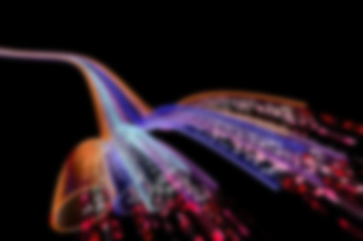
Data Exchange
Node
Message
Data
Notes:
There are three types of data exchange
[click] Node API helps you know when two devices are connected, which is when you can exchange data and messages between your phone and the wearable.
[click] Message API allows you to exchange low latency messages. Great for RPCs.
[click] Data API give you the ability to store data that’s shared between the phone and wearable and automatically buffered when the devices are disconnected

Slide 40
Create a GoogleApiClient
GoogleApiClient mGoogleApiClient = new GoogleApiClient.Builder(this) .addConnectionCallbacks(new ConnectionCallbacks() { public void onConnected(Bundle connectionHint) { // Now you can use the data layer API }
... }) .addOnConnectionFailedListener(new OnConnectionFailedListener() { public void onConnectionFailed(ConnectionResult result) { } }) // Request access only to the Wearable API .addApi(Wearable.API) .build();
mGoogleApiClient.connect();
Notes:
Node API
Can get connected nodes at any time
Or be notified when a peer connects or disconnects

Slide 41
Check for connected nodes
nodes = Wearable.NodeApi
.getConnectedNodes(mGoogleApiClient)
.await();
nodeList = nodes.getNodes();
if (nodeList.size() > 0) { connectedNode = nodeList.get(0); }
Notes:
Node API
Can get connected nodes at any time
Or be notified when a peer connects or disconnects

Slide 42
Send a message
result = Wearable.MessageApi .sendMessage(mGoogleApiClient, parentNode.getId(), "/start/MainActivity/", message.getBytes()); result.setResultCallback(new ResultCallback<MessageApi.SendMessageResult>() { public void onResult(MessageApi.SendMessageResult sendMessageResult) {
if (!sendMessageResult.getStatus().isSuccess()) {
// handle error } } });
Notes:
Message API
Send a message and be notified when one is received

Slide 43
Receive a message
@Override public void onMessageReceived(MessageEvent messageEvent) { String message = new String(messageEvent.getData()); }
Notes:
Implement MessageListener
Override onMessageReceived

Slide 44
Send a data
map = PutDataMapRequest.create("/image"); map.getDataMap().putAsset("image”,assetFromBitmap);
PutDataRequest request = map.asPutDataRequest(); pendingResult = Wearable.DataApi
.putDataItem(mGoogleApiClient,request);
Notes:
Data API
Put and Get data items
Get notified when data is changed

Slide 45
Receive a data
@Override public void onDataChanged(DataEventBuffer dataEvents) {
for (DataEvent event : dataEvents) { if (event.getType() == DataEvent.TYPE_CHANGED && event.getDataItem()
.getUri().getPath()
.equals("/image")) {
dataMapItem = DataMapItem
.fromDataItem(event.getDataItem());
profileAsset = dataMapItem.getDataMap()
.getAsset("image"); } }
}
Notes:
Implement DataListener
Override onDataChanged
Data type: DELETED, CHANGED

Slide 46
public class MyWearListener extends WearableListenerService { @Override public void onMessageReceived(MessageEvent messageEvent) { } @Override public void onDataChanged(DataEventBuffer dataEvents) { } @Override public void onPeerConnected(Node peer) { } @Override public void onPeerDisconnected(Node peer) { } }
Notes:
To receive data, you will need the WearableListenerService
You would usually create instances of this service in both your wearable and handheld apps.
If you don't care about receiving data events in one of these apps, then you don't need to implement this service in that particular app.
Simply create a class that extends WearableListenerService.
Listen for the events that you care about, such as onDataChanged().

Slide 47
Intent Filter
<service android:name=”.MyWearListener" >
<intent-filter>
<action android:name="com.google.android.gms.wearable.BIND_LISTENER" />
</intent-filter>
</service>
Notes:
Declare an intent filter in your Android manifest to notify the system about your WearableListenerService.
This allows the system to bind your service as needed.

Slide 48
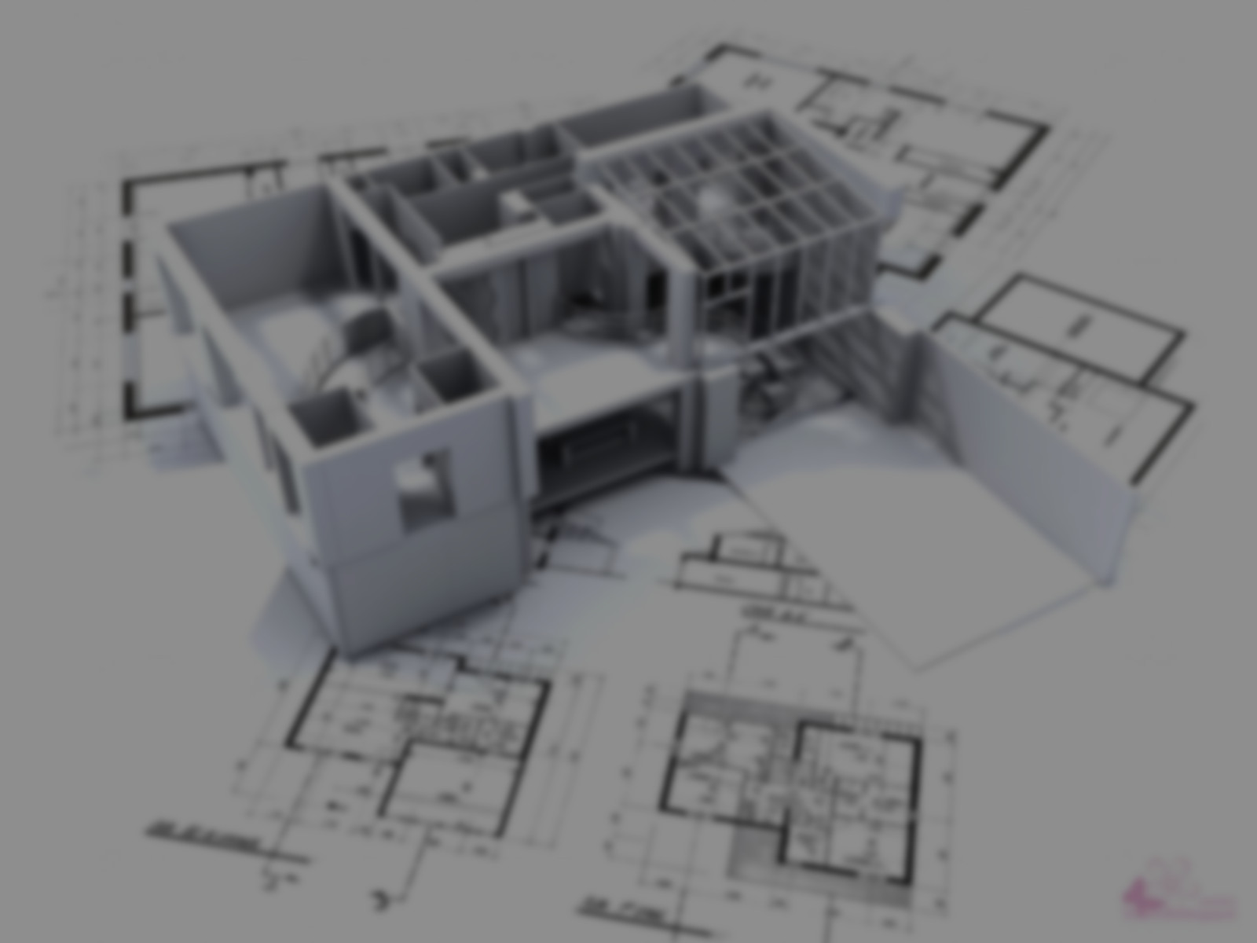
Custom Layouts
Notes:
Now we’ll talk about custom layouts

Slide 49
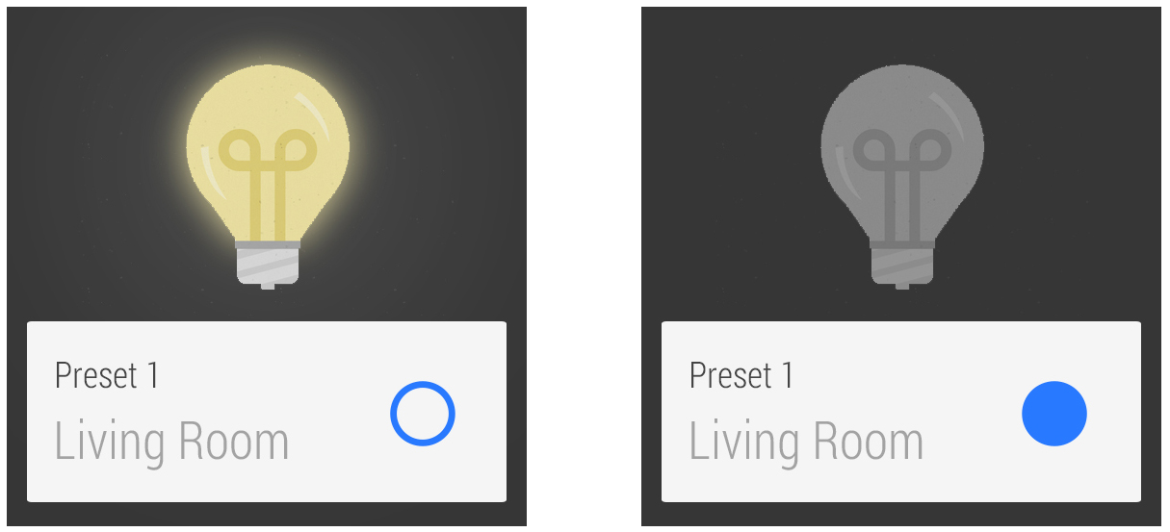
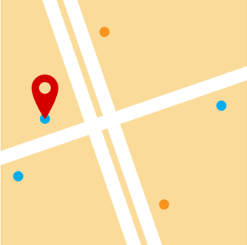
Notes:
In general, you should create notifications on the handheld and let them automatically sync to the wearable. This lets you build your notifications once and have them appear on many types of devices.
If the standard notification styles don't work for you (such as NotificationCompat.BigTextStyle or NotificationCompat.InboxStyle), you can display an activity with a custom layout.
You can only create and issue custom notifications on the wearable, and the system does not sync these notifications to the handheld.
There’s a UI support library that helps you build UIs that are designed for wearables.
It’s automatically included when you create your wearable app with the Android Studio Project Wizard.

Slide 50
BoxInsetLayout Card Fragment CircledImageView ConfirmationActivity DismissOverlayView DelayedConfirmationView | GridViewPager GridPagerAdapter FragmentGridPagerAdapter WatchViewStub
Notes:
These are some of the major classes you get

Slide 51
WatchViewStub
<?xml version="1.0" encoding="utf-8"?> <android.support.wearable.view.WatchViewStub xmlns:android="http://schemas.android.com/apk/res/android" xmlns:app="http://schemas.android.com/apk/res-auto" xmlns:tools=http://schemas.android.com/tools app:rectLayout="@layout/rect_activity_main" app:roundLayout="@layout/round_activity_main" tools:context=".Main" tools:deviceIds="wear" android:padding="12dp"> </android.support.wearable.view.WatchViewStub>
Notes:
A class that can inflate a specific layout, depending on the shape of the device's screen.

Slide 52
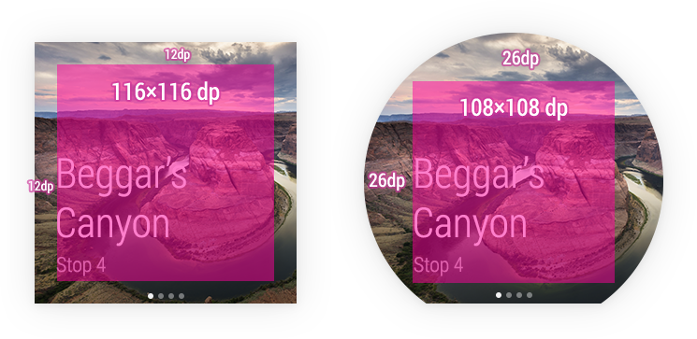
BoxInsetLayout
Notes:
A FrameLayout that's aware of screen shape and can box its children in the center square of a round screen.

Slide 53
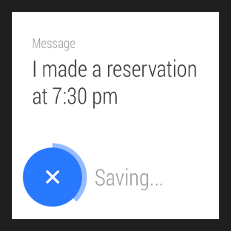
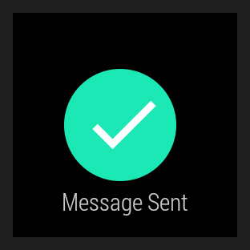
DelayedConfirmationView & ConfirmationActivity
Notes:
DelayedConfirmationView
shows users an animated timer that lets them cancel an action they just performed.
ConfirmationActivity
gives users visual feedback when they complete an action.

Slide 54
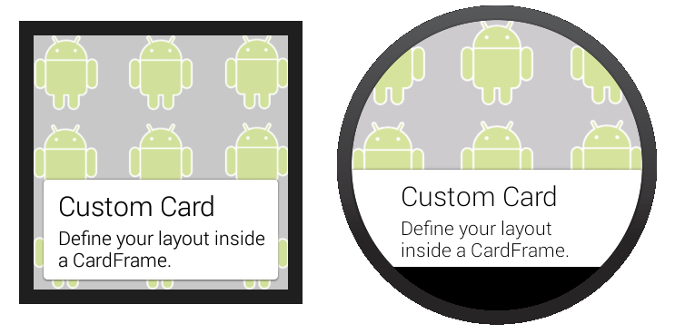
CardFragment
Notes:
Cards present information to users with a consistent look and feel across different apps.

Slide 55

Voice Actions
Notes:
Now let’s talk about voice actions. Voice actions allow you to use the built-in speech input API to launch an app or as a way for your users to input values

Slide 56
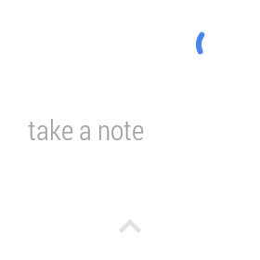
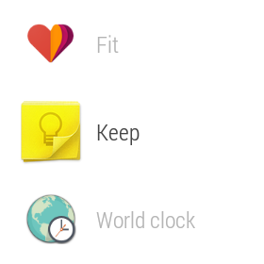
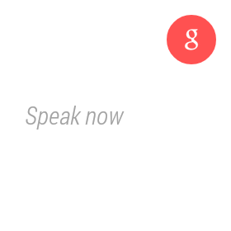
Notes:
[click] System-provided actions are task-based and built into the wear platform and specified with an intent-filter.
[click] App-provided actions are app-based and are declared like a launcher icon.
[click] Free-form Speech Input uses the Speech Recognizer activity to get speech input from the user.

Slide 57
System Provided Action
<activity android:name="MyNoteActivity">
<intent-filter>
<action android:name="android.intent.action.SEND" />
<category android:name="com.google.android.voicesearch.SELF_NOTE" />
</intent-filter>
</activity>
Notes:
System provided voice actions
You filter for them in the activity that you want to start when the voice action is spoken.
Examples include "Take a note" or "Set an alarm".

Slide 58
Call a car/taxi Take a note Set alarm Set timer Start/Stop a bike ride | Start/Stop a run Start/Stop a workout Show heart rate Show step count
Notes:
These are the commands available on Android Wear today

Slide 59
App Provided Voice Action
<activity android:name="StartRunActivity" android:label="MyRunningApp">
<intent-filter>
<action android:name="android.intent.action.MAIN" />
<category android:name="android.intent.category.LAUNCHER" />
</intent-filter>
</activity>
Notes:
App provided voice actions
These voice actions are app-based, and you declare them just like a launcher icon.
Users say "Start " to use these voice actions and an activity that you specify starts.

Slide 60
Speech Recognizer
private void displaySpeechRecognizer() { Intent intent = new Intent(RecognizerIntent.ACTION_RECOGNIZE_SPEECH);
intent.putExtra(RecognizerIntent.EXTRA_LANGUAGE_MODEL, RecognizerIntent.LANGUAGE_MODEL_FREE_FORM); startActivityForResult(intent, SPEECH_REQUEST_CODE); }
Notes:
Speech recognizer
In addition to using voice actions to launch activities, you can also call the system's built-in Speech Recognizer activity to obtain speech input from users.
This is useful to obtain input from users and then process it, such as doing a search or sending it as a message.

Slide 61
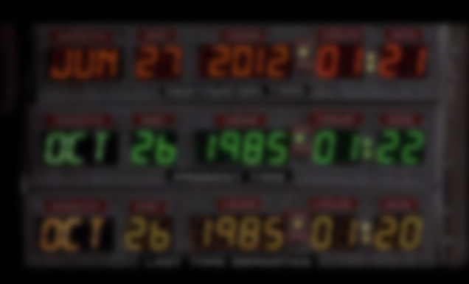
Watch Faces
Notes:
Ok, now let’s move on to watch faces

Slide 62
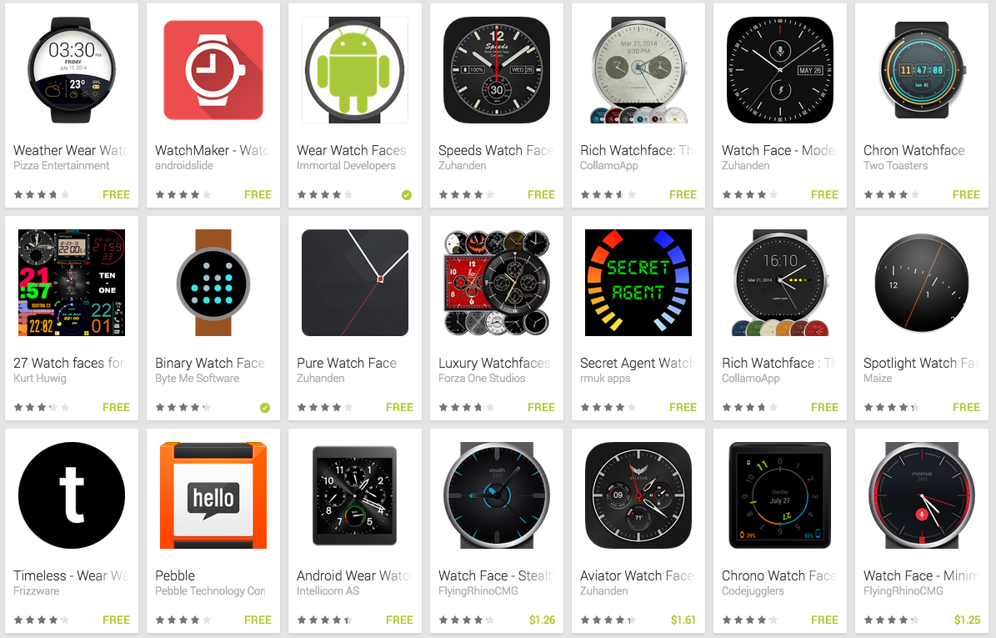

Slide 63
UNOFFICIAL

Slide 64
Create a Wear Watch Face
Same steps as creating a wearable app
Uses Executors for per-second updates
Uses Intent.ACTION_TIME_TICK for per-minute updates
Use DisplayManager for screen events
HACK!

Slide 65
Create a Wear Watch Face

Slide 66
Modify AndroidManifest.xml
<activity android:name="com.marctan.hellowatchface.MainActivity" android:label="@string/app_name" android:allowEmbedded="true">
<meta-data android:name="com.google.android.clockwork.home.preview" android:resource="@drawable/ic_launcher" /> <intent-filter> <action android:name="android.intent.action.MAIN" /> <category android:name="com.google.android.clockwork.home.category.HOME_BACKGROUND" /> </intent-filter>
. . . </activity>

Slide 67
DisplayListener Events
public void onDisplayAdded(int i) { } public void onDisplayRemoved(int i) { } public void onDisplayChanged(int displayId) { switch(displayManager.getDisplay(displayId).getState()){
case Display.STATE_OFF: case Display.STATE_DOZING: updateEveryMinute(); break; default: updateEverySecond(); break; } }

Slide 68
Per-second updates
private void updateEverySecond() {
. . . scheduledFuture = scheduleTaskExecutor.scheduleAtFixedRate(new Runnable() { public void run() { updateClockView(); } }, 0, 1, TimeUnit.SECONDS); }

Slide 69
Per-minute updates
private void updateEveryMinute() { if (scheduledFuture != null) { scheduledFuture.cancel(true); } ClockManager.getInstance().setAmbientMode(true); }

Slide 70




Hello Wear Watch Face

Slide 71
Demo

Slide 72
Thank You
Source Code
github.com/mharkus/DevfestGeorgeTown2014
Android Wear Dev Documentation
developer.android.com/wear/index.html
My Blog
marctan.com

Slide 73
Android Wear: A Developer’s Perspective

Slide 74
Android Wear: A Developer’s Perspective

